Slide 1


Lead Poisoning Toolkit 2026
Guidelines For Maryland Practitioners
Maryland Chapter American Academy of Pediatrics
Paul T. Rogers MD MBA FAAP
Michael Ichniowski, MD, FAAP

Slide 2
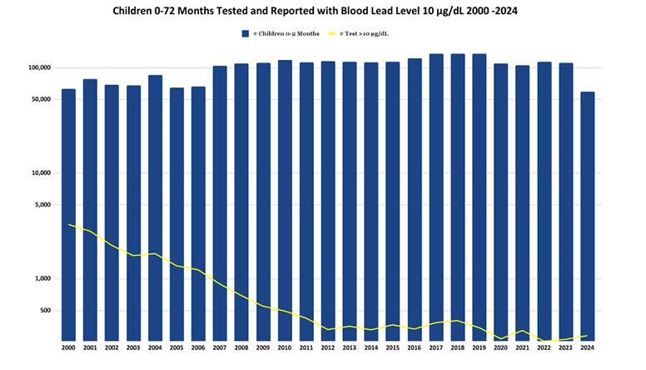
Introduction: ….still treating lead poisoning after all these years
Good News: Dramatic reduction in prevalence and incidence of Maryland children with elevated Blood Lead levels (BLL)
*From Maryland Department of the Environment annual report, October 2024:
https://mde.maryland.gov/programs/land/leadpoisoningprevention/pages/healthcare.aspx

Slide 3

Introduction: However…….
Bad News: Lead poisoning still major problem
Lead exposure still represents the most significant environmental concern for young children in Maryland.
In 2024, 2,351 Maryland children had elevated BLL ≥ 3.5 µg/dL which can cause neuropsychological impairments, learning problems, and behavior disorders.

Slide 4
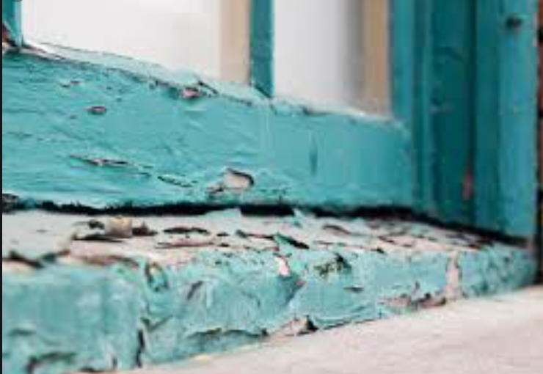
Exposure to Lead Hazards in Maryland
a. Deteriorated lead-based paint and lead contaminated house dust remain the most frequent source of lead poisoning in Maryland children*.
b. Houses built before 1978 are considered to have lead-based paint till proven otherwise.
c. Remodeling in a house built before 1978 may release large amounts of lead contaminated house dust.
d. Low-income families more likely to be renting properties at risk for lead hazards.
e. Sources of information about the year a house was built:
MD Department of Assessments and Taxation: https://sdat.dat.maryland.gov/RealProperty/Pages/default.aspx
ii. Zillow: https://www.zillow.com/md/
*From Maryland Department of the Environment annual report, October 2020.

Slide 5





Additional lead hazards*
Imported painted toys
Parent occupation or hobby: lead dust firearms range
Kohl-imported cosmetics
Imported spices, especially turmeric & cinnamon
Children recently arrived in MD
*See US Consumer Product Safety Commission for recent recalls: https://www.cpsc.gov/Recalls?combine=lead+in+products&=Apply&field_rc_date%5Bdate%5D=&field_rc_date_1%5Bdate%5D=
Notes:
NOTE: To change images on this slide, select a picture and delete it. Then click the Insert Picture icon in the placeholder to insert your own image.

Slide 6
Toxicokinetics: Absorption and Distribution of Lead in the Body*
Exposure pathway
Absorption by GI tract
Most commonly, lead contaminated house dust is transferred into a child’s body by hand to mouth activity
Young children with pica are at greatest risk for lead ingestion
Pregnant women with current or previous lead poisoning history can transmit lead to the fetus by trans-placental route
The percent of lead absorbed by young child is 50% (100% on an empty stomach) compared to 10% in an adult.
Lead absorption is enhanced by high fat diet, smaller particulate size, and deficiencies in Iron, Calcium, and Zinc
*EPA ISA 2013: https://www.epa.gov/isa/integrated-science-assessment-isa-lead

Slide 7
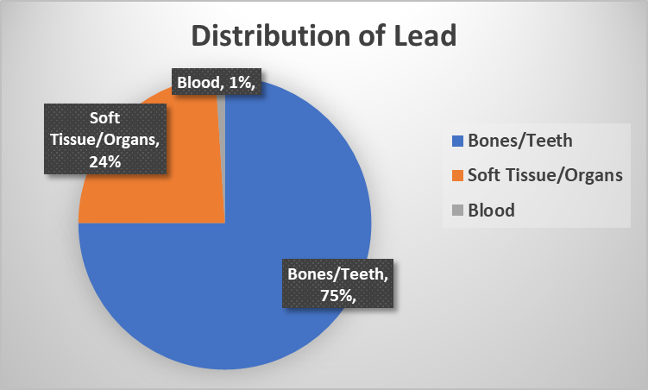
Toxicokinetics: Absorption and Distribution of Lead in the Body*
Bones and teeth
  The half-life of lead into bones is up to 20 years.
  Release of lead back to the blood is increased in stress, pregnancy, and chronic disease.
Soft tissue (brain, liver, kidneys)
a. Brain is target organ
b. The half-life of lead in the brain is up to 2 years
3. Blood
  The half-life lead in blood after acute ingestion is ~30 days and up to a year with chronic elevated BLL
  An elevated blood lead level measures recent absorption as well as lead released from bones from previous absorption
*EPA ISA 2013: https://www.epa.gov/isa/integrated-science-assessment-isa-lead

Slide 8
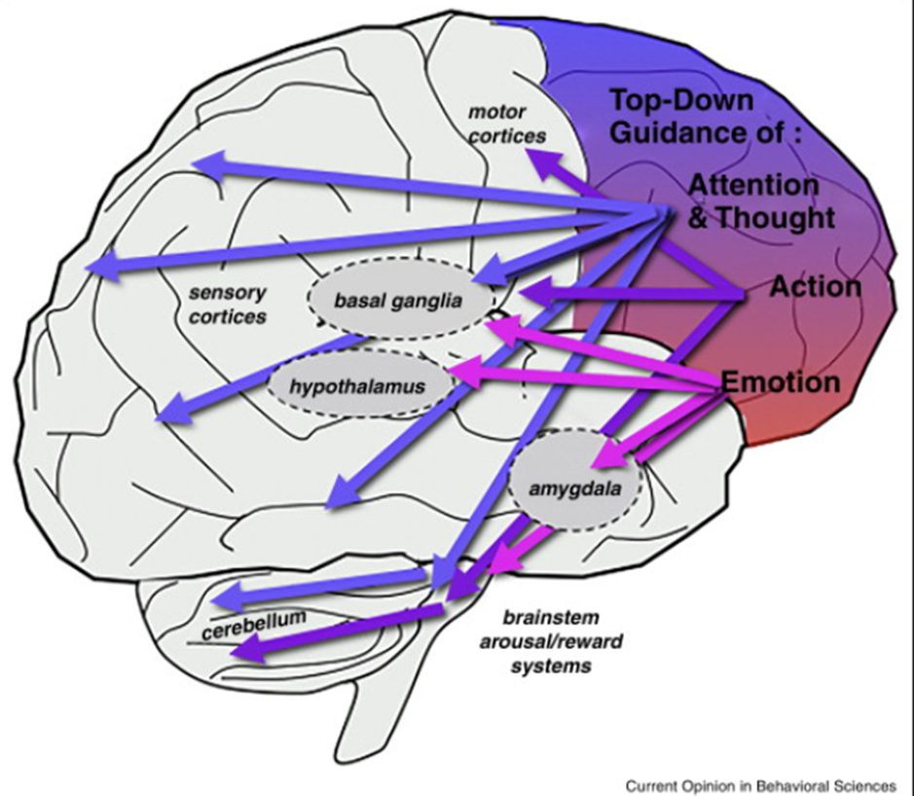
Neurotoxic Effects of Lead Poisoning: the Neuro-psychological Deficits in Children*
Cognition: dose dependent decrease in IQ points
Executive function: Impulse control, Emotional Control, Self-Monitoring, Planning and Prioritizing, Task Initiation, and Organization
Attention: short attention span, hyperactivity, distractible
Academic progress: reading problems, higher absenteeism rates, behind grade level
Memory: decrease in verbal and visual memory
Affect: increase in oppositional, aggressive, and anti-social behaviors
Language: impaired verbal concept formation, poor grammatical, and reasoning
Processing speed: slowed decision-making abilities and reaction times
*Mason, L. Pb Neurotoxicity: Neuropsychological effects lead toxicity. BioMed Research International. Volume 2014, Article ID 840547, 1-8 .Jan 2, 2014.

Slide 9

The Effects of a History of Childhood Lead Poisoning on Adults
Further loss of IQ points*
Early onset dementia
Decrease vocational opportunities and reduced lifetime income
Anxiety and depression
Downward social mobility
Medical conditions
  Hypertension
  Coronary artery disease
  Male and female reproductive function
  Cancer
*Reuben, A. Association of childhood blood-lead levels with cognitive function and socioeconomic status at 38 years and IQ change and socioeconomic mobility between childhood and adulthood. JAMA. 2017 March 28: 317(12): 1244-1251
#EPA ISA 2013

Slide 10

Screening for Lead Poisoning: Identifying Children at Risk*
Perform Lead Risk Assessment Questionnaire
Clinical assessment, including health history, developmental screening and physical exam
Evaluate nutrition and consider iron deficiency
Educate parent/guardian about lead hazards
*https://phpa.health.maryland.gov/OEHFP/EH/Pages/Lead.aspx

Slide 11
Screening for Lead Poisoning: Lead Risk Assessment Questionnaire*
1. Lives in or regularly visits a house/building built before 1978 with peeling or chipping paint, recent/ongoing renovation or remodeling?
2. Ever lived outside the United States or recently arrived from a foreign country?
3. Sibling, housemate/playmate being followed or treated for lead poisoning?
4. If born before 1/1/2015, lives in a 2004 “at risk” zip code?
5. Frequently puts things in his/her mouth such as toys, jewelry, or keys, eats non-food items (pica)?
6. Contact with an adult whose job or hobby involves exposure to lead?
7. Lives near an active lead smelter, battery recycling plant, other lead-related industry, or road where soil and dust may be contaminated with lead?
8. Uses products from other countries such as health remedies, spices, or food, or stores or serves food in leaded crystal, pottery or pewter?
*https://phpa.health.maryland.gov/OEHFP/EH/Pages/Lead.aspx

Slide 12
Testing for Lead Poisoning: Indications*
All children born on or after 1/1/2015 tested at 12 and 24 months (Effective 3/28/2016)
For children born before 1/1/2015 follow targeted testing guidelines
3. Parental/guardian request
4. Possible lead exposure or symptoms of lead poisoning, either from health history, development assessment, physical exam or newly positive item on Lead Risk Assessment Questionnaire.
5. Follow-up testing on a previously elevated Blood Lead Level
6. Missed screening: If 12-month test was indicated and no proof of test, then perform as soon as possible after 12 months and then again at 24 months. If 24-month test was indicated and no proof of test, then perform test as soon as possible.
*https://phpa.health.maryland.gov/OEHFP/EH/Pages/Lead.aspx

Slide 13
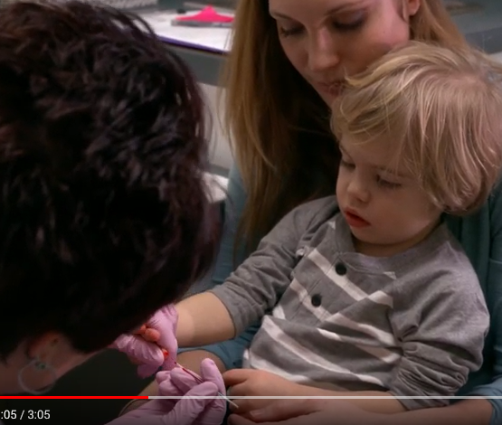
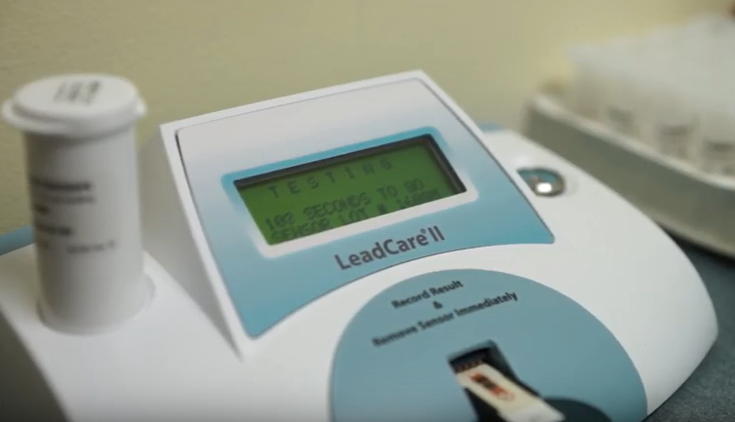
Point of Care Testing
Recommended by Maryland Department of Health
CLIA waived
Increased compliance
Cost effective
Not disruptive to office operations
Minimal time to train staff
Well accepted by parents and patients
Pictures from video: https://www.youtube.com/watch?v=B1ycx4DtPfY&feature=youtu.be

Slide 14
Clinical Guidelines on New CDC Blood Lead Reference Level*
The CDC announced October 28, 2021, that it has updated its blood lead reference value from ≥ 5 µg/dL to ≥ 3.5 µg/dL.
Currently the legal definition of elevated blood lead level in Maryland remains at ≥ 5 µg/dL however,
the Maryland Department of the Environment and the Maryland Department of Health officially use the stricter blood lead reference value of 3.5 µg/dL to trigger public health interventions and notices.
Providers need to follow-up on children with blood lead levels of 3.5 – 4.9 µg/dL to ensure that the child’s blood lead levels are not increasing, an indication of ongoing exposure.
*Letter to Maryland providers January 21, 2022, from Dr. Cliff Mitchell, Director Environmental Health Bureau, Maryland Department of Health

Slide 15
CDC Recommended Actions Based on Blood Lead Level *
Patient’s venous BLL is < 3.5 μg/dL
Provide education about common sources of lead exposure and information on how to further prevent exposure.
During well-child visits, check development to make sure age-appropriate milestones are being met.
During well-child visits, discuss diet and nutrition with a focus on iron and calcium intake.
Conduct follow-up blood lead testing at recommended intervals based on the child’s age.
Venous blood lead levels (µg/dL) | Early follow up testing (2–4 tests after initial test above specific venous BLLs) | Later follow up testing after BLL declining
≥3.5–9 | 3 months* | 6–9 months
10–19 | 1–3 months* | 3–6 months
20–44 | 2 weeks–1 month | 1–3 months
≥45 | As soon as possible | As soon as possible
*Adopted from https://www.cdc.gov/nceh/lead/advisory/acclpp/actions-blls.htm posted on-line March 15, 2022

Slide 16
Preventing Childhood Lead Poisoning
“Primary prevention, reducing or eliminating the myriad sources of lead in the environment of children before exposure occurs, is the most reliable and cost-effective measure to protect children from lead toxicity.”*
Follow Maryland guidelines for screening children and pregnant women.
Recommend environmental assessment of older homes built before 1960 especially if there has been recent repair or renovation work.
Educate parents about lead hazards
Make sure children eat healthy diets with adequate iron and calcium to help minimize absorption when exposed to lead hazards
Inquire about where children visit or goes for daycare to make sure those properties are lead safe
*AAP policy Statement June 26, 2016: https://pediatrics.aappublications.org/content/138/1/e20161493

Slide 17

Key Points
There is no safe blood lead level
The sources today for most cases of lead poisoning are lead contaminated dust and deteriorated paint
Low-income and minority families are disproportionately affected by lead poisoning
Primary prevention (preventing exposure) is the most effective way to protect children from lead poisoning

Slide 18
Reference Articles on Treating Children With Lead Poisoning
1. AAP Policy Statement 2016: Prevention of Childhood Lead Toxicity
https://publications.aap.org/pediatrics/article/138/1/e20161493/52600/Prevention-of-Childhood-Lead-Toxicity
2. American Family Physician 2015: Lead Poisoning
https://pubmed.ncbi.nlm.nih.gov/31259498/
3. Pediatric Review: Lead Poisoning: An Update 2021
https://pubmed.ncbi.nlm.nih.gov/34074717/
4. Clinical Pediatrics 2018: Lead Poisoning and Children in Foster Care: Diagnosis and Management Challenges
https://www.ncbi.nlm.nih.gov/pmc/articles/PMC6982421/
5. Agency for Toxic Substances and Disease Registry 2019 Case Study: How Should Patients Exposed to Lead Be Treated and Managed?
https://www.atsdr.cdc.gov/csem/leadtoxicity/patient_treatment.html
6. Clinical Pediatrics 2019: Children With Autism Spectrum Disorder and Lead Poisoning: Diagnostic Challenges and Management Complexities
https://pubmed.ncbi.nlm.nih.gov/30938166/
7. Clinical Pediatric Emergency Medicine 2017: An Update on Childhood Lead Poisoning
https://www.ncbi.nlm.nih.gov/pmc/articles/PMC5645046/

Slide 19
Resources
Mid-Atlantic Center for Children’s Health & the Environment
Pediatric Environmental Health Specialty Unit
866-622-2431
kidsandenvironment@georgetown.edu
www.pehsu.net/region3.html
Mt. Washington Pediatric Hospital Lead Treatment Program
410-367-2222
www.mwph.org
Maryland Poison Control
800-222-1222
Maryland Department of Health
(410) 767-6500 or 1-877-463-3464
dhmh.envhealth@maryland.gov
http://phpa.dhmh.maryland.gov/ OEHFP/EH/Pages/Lead.aspx
Maryland Department of the Environment
Lead Poisoning Prevention Program
410-537-3825/800-776-2706
http://www.mde.state.md.us/programs/ Land/LeadPoisoningPrevention/Pages/ index.aspx
Local Health Departments
http://dhmh.maryland.gov/PAGES/ DEPARTMENTS.ASPX
Centers for Disease Control and Prevention
www.cdc.gov/nceh/lead/
Green & Healthy Homes Initiative
410-534-6447
800-370-5223
www.greenandhealthyhomes.org/
​Maryland Dept. Health Best Practices For Lead Poisoning Prevention And Treatment Videos
Parent: https://www.youtube.com/watch?v=B1ycx4DtPfY&feature=youtu.be
Providers: https://www.youtube.com/watch?v=aJ6QGcBB0Nc&feature=youtu.be

